Slide 1
Wolf Creek Public Schools
2020-2021
ACE Plan: Action – Collaboration - Evidence
(Insert school name here)
Lacombe Outreach School

Slide 2
School Celebrations and Highlights
School Demographic | School Mission, Vision & Values | Program Highlights | Celebrations
LO Enrollment: Connections- 11 Grade 10- 18 Grade 11- 25 Grade 12 3 year-31 4 year-19 5 year-7 Upgrading 41 | School Mission, Vision and Values-can be found at the following link: https://los.wolfcreek.ab.ca/about/documents Open LOS Handbook | High School Advisor | 52 graduates
LO School Staffing https://docs.google.com/document/d/1ZMbY9oNGzwFsYhpSQCulo6yrzhvrBkDmUzUVWljJK2k/edit# |  | Covid-19 Implementation of School Plan | Our response to COVID in March Student tracking Work completion Daily Meetings Module offerings
 |  | New Building | School Pack-up & Move Staff Participation Clean-up & organization of both sites Facilities relationship

Slide 3
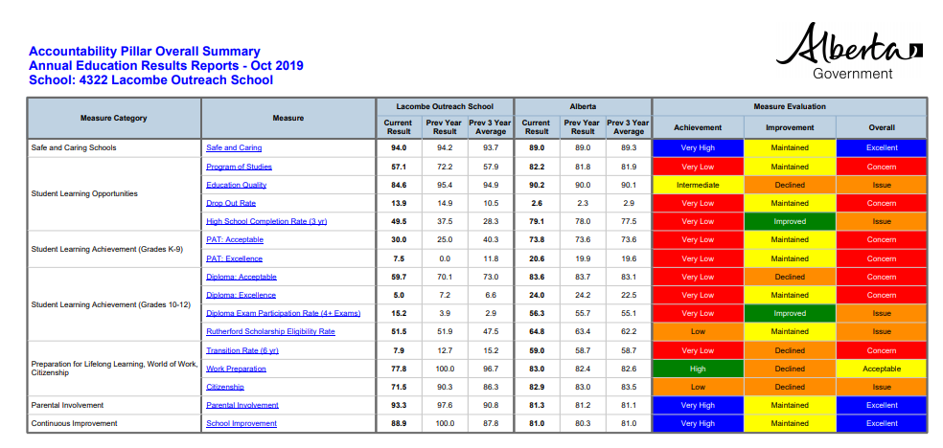
Accountability Pillar / AERR

Slide 4
Accountability Pillar Data Strategic Planning
Area of Issue, Concern, or Focus | Identified Improvement Target | Specific Strategies | Indicators of Success
Gathering accurate and valid AERR data from survey | Increasing the number of respondents of students and parents on AERR survey | Review current data with staff Review survey guidelines and meaning of responses in AERR survey to student participants Involve Parent Council | AERR data that is more valid I00% completion by attending students Have a minimum of 8 parent completed surveys
Moving towards the Assurance Model | Writing School Based assessment items that will be used in new model | Staff involvement (time given on PD days throughout the school year) Writing effective survey questions, editing sessions with staff. Short term vs long term information gathering (what is the purpose of the item) | Generate a list of at least 10 school specific survey questions for parents and students. Have these questions ready for the new Assurance model.

Slide 5
Local School Data Strategic Planning
Area of Issue, Concern, or Focus | Identified Improvement Target | Specific Strategies | Indicators of Success
Module completion of students during Covid-19 | Module & Subject Completion | Tracking Sheet -progressive interventions starting with staff contacts and then admin https://docs.google.com/spreadsheets/d/1O_8sE1UZQ7_wDm1SSo6Q5TbMmuVR-rjx0A1T0ZwYEmM/edit?usp=sharing | Work Completions Regular School contact Increased in school attendance.
 | Communications between school and home | CRM - monitor students at risk and identify barriers / lagging skills | Admin Tracking Meet each student a minimum of 2 times per semester Goal setting(module based)
 | Graduation Rates | MH issues refer to SSW | Determine if attendance and work completion is related to anxiety
Numeracy & Literacy | Increase Numeracy, Reading & Vocabulary | Read 180 for Connections Program Key Math Individualized Student Programming Using modified versions | Read 180 & STAR reading results Key Math results IPP programming in Dosier

Slide 6
Deepening Capacity in Learning Practices
Within the goal areas from the District 3 Year Plan, please identify areas within Focus Area One related to ongoing growth in your school..
Area of Focus | Specific Strategies | Indicators of Success
Support and expand off campus programming | Work closely with Kylie Kissell , Dave Brown, Pamela Church Provide training opportunities for new OC teacher. (webinars) Provide student information sessions and workshops Look into the possibility of becoming a skills school | 5% increase in students accessing either Dual Credit, SWAC, RAP, Green Certificate and Work Experience
Deepening our FNMI knowledge | Explore the Walking Together Resource | Explored at least three areas of the Walking Together resource

Slide 7
Building Capacity in Inclusion
Within the goal areas from the District 3 Year Plan, please identify areas within Focus Area Five related to ongoing growth in your school.
Area of Focus | Specific Strategies | Indicators of Success
Strengthening our Tier 1 Intervention Supports | Student Advisor to gather individual student information Learning Strategies with Advisor | Scheduled monthly meetings with advisor Improved student awareness into credits earned, DAR report and course offerings Improve number of students successfully reaching graduation requirements. Individualized Plans reflected in student specific strategies
Implementation of CRM and ALSUP | Use CRM process to identify and program for student success ALSUP to help identify lagging skills and focus CRM strategies | Introduce staff to Ross Green and ALSUP School wide PD on ALSUP Use of forms when appropriate during CRM process
Trauma Informed Classroom | PD continuation from last year on book study “Fostering Resilient Learners” Book Study for all staff- see PD plan | Completion of the book study Team discussion Relevance to our school

Slide 8
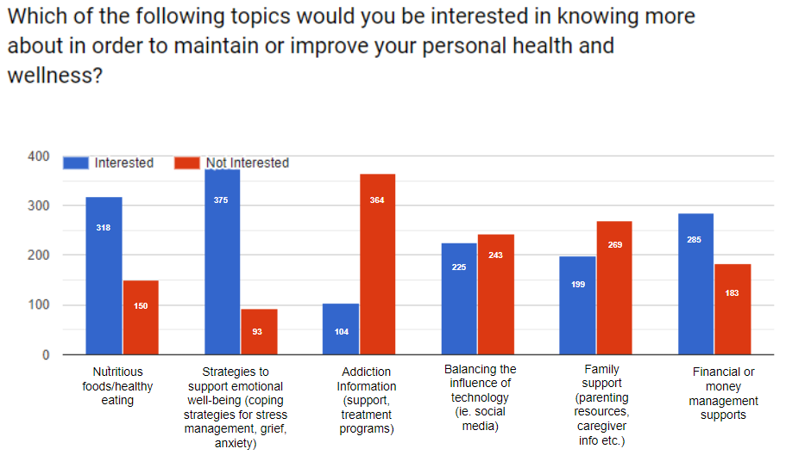
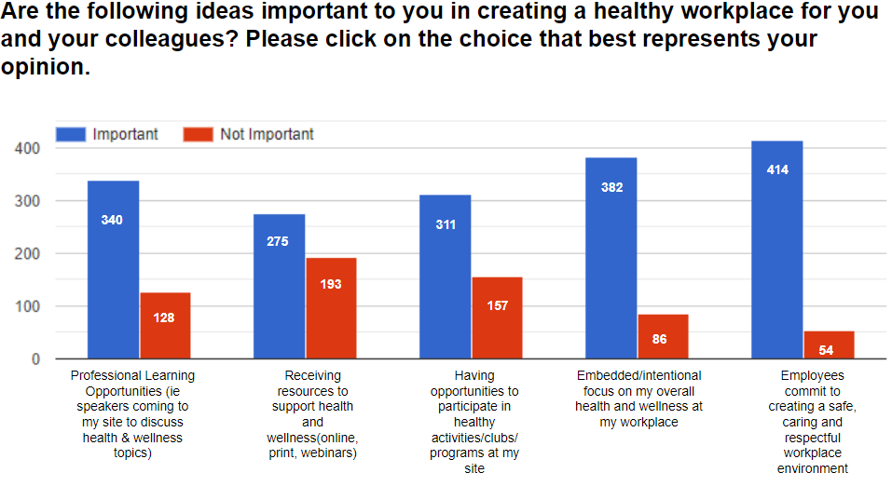
Health & Wellness Strategic Planning
Re-Entry Support Resources
Psychological First Aid

Slide 9
Health & Wellness Strategic Planning
Area of Focus | Specific Strategies | Indicators of Success
Health of Teaching Staff Team Building | Team Building Activities Hike Bring in Nutritionist Care Package | Wellness survey in May
Fitness | Fitness Challenge Participate in the February fitness challenge Hike in spring (if allowed)
Social/Emotional | Mental Health speaker

Slide 10
School Professional Development Plan
Please provide a comprehensive plan for how your school will leverage the Aligned Calendar Days and other opportunities throughout the 2018-19 School Year to implement and attend to the strategies that have been identified to meet the improvement targets in your ACE Plan.
LOS PD plan
https://docs.google.com/document/d/1mbAS5UngcyTKkBLhyzLCWN54vpaZVcUkZoB2QRxaJCA/edit

